Slide 1
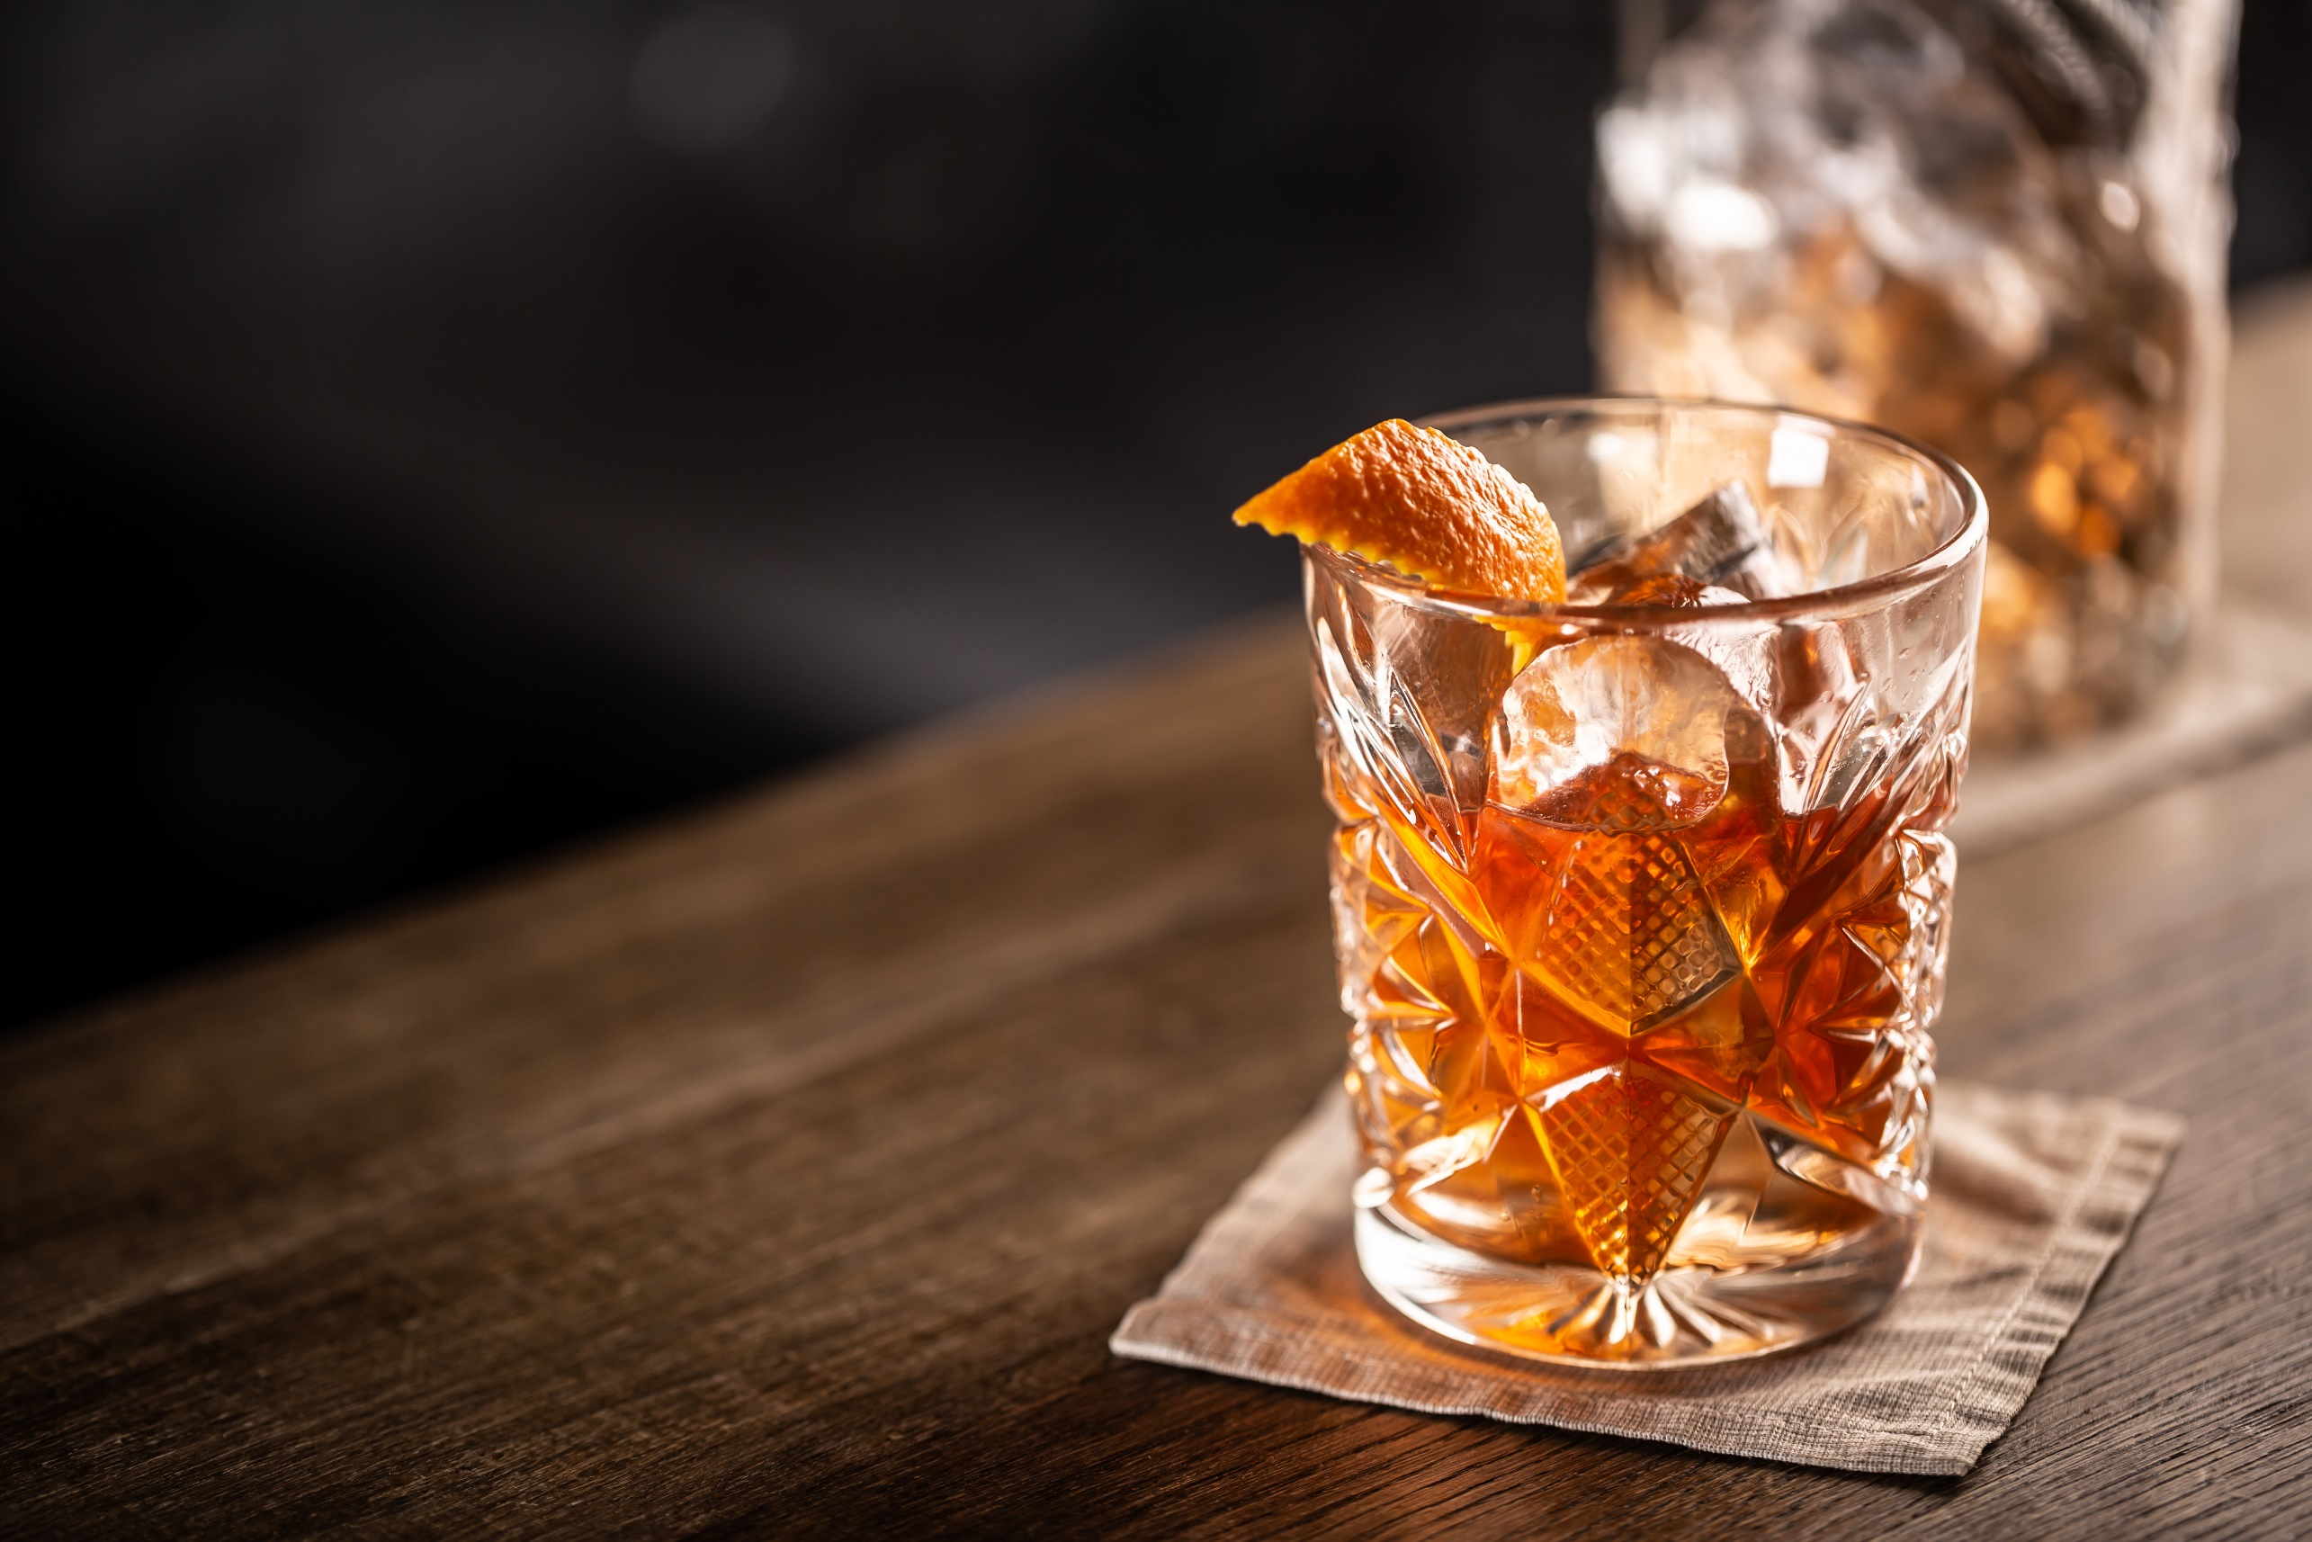

Research in Action
Case Study on Jim Bean Versus Their Competitors
in the Whiskey Market
| 2021 Q1 |

Slide 2

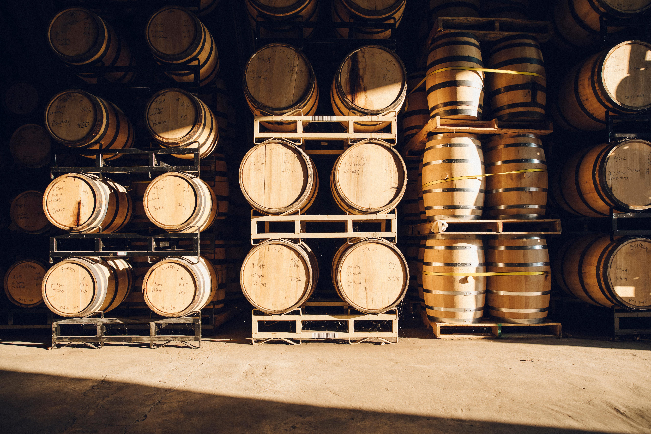




Why did we run this case study?
BACKGROUND
Whiskey is an ultra-competitive market that has existed for hundreds of years. Some household names have had a vice-grip on the market for a long time. But new-comers are beginning to gain traction and have become important players. This combined with millennials having a hold on the market, and Gen-Z coming of age makes it important to keep a birds-eye view on trends.
WHAT WE TESTED
We ran a short survey with consumers who buy whiskey to get a high-level view into the health of various whiskey brands in the market. Survey results were utilized to compare 12 brands and weigh their performance against one another.
We explored:
How do the top brands measure against each other along key funnel metrics?
What is Jim Beams place in the market?
What does Jim Beam do best and what are the areas of opportunity?
The insights that follow represent the views, perceptions, and behaviors of 251 survey participants across the U.S. These interviews took place Q1, 2021.
Given the relatively small sample size involved, these findings should be interpreted as directional at best. [Your Organization] advises validating these findings using larger sample sizes before taking action against the insights.

Slide 3


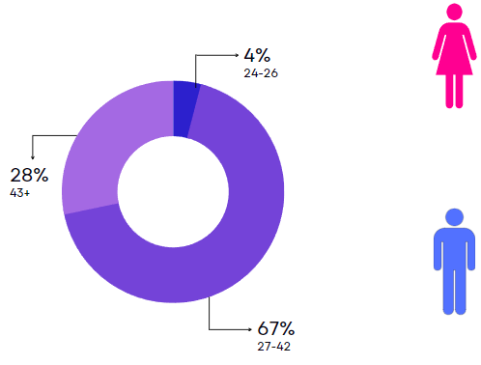


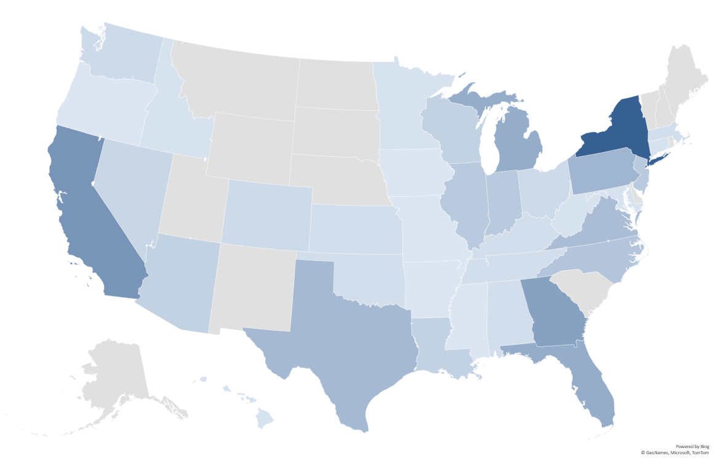
Who was surveyed?
This survey took responses from a small pool of consumers from all over the United States with the grand majority being Millennials.
LOCATION
AGE
59%
FEMALE
41%
MALE
A combined 36% of survey replies came from New York, California, Georgia, and Florida.

Slide 4
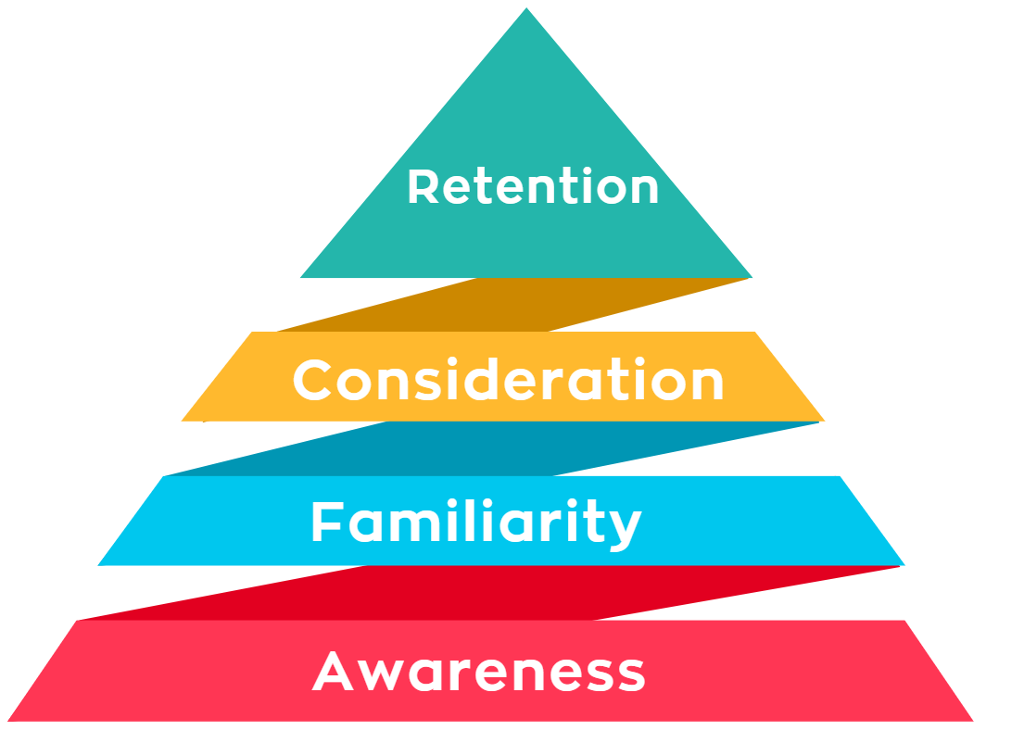



What are the key funnel metrics?
Our key funnel metrics showcase the journey from broad brand awareness, narrowing down to fewer consumers as we reach familiarity and consideration. Retention represents an opportunity to convert awareness into lasting loyalty.
You will see a metric labeled “P12M”. This is referring to consumers who’ve purchased the product in the past 12 months.

Slide 5
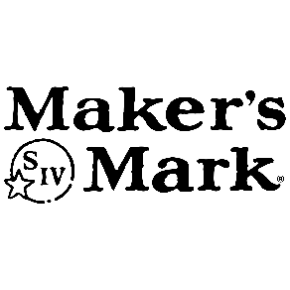
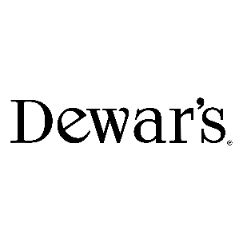
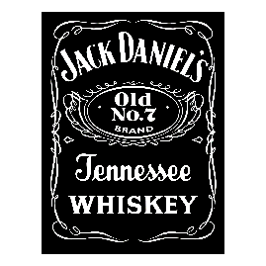
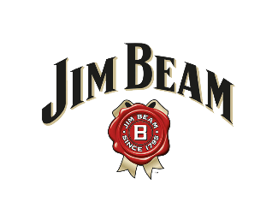

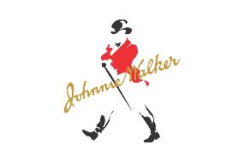
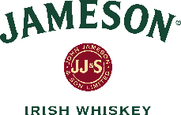

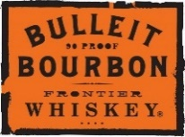


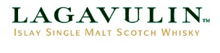

How does Jim Bean and their competitors match up against each other along key funnel metrics?
Jim Beam and Jack Daniel’s are neck and neck at the highest levels of awareness, with the next closest competitors trailing behind by over 9%. Jack Daniel’s has the highest correlation between awareness and familiarity among the top-ranking brands - with only a 6% disparity compared to the next top ranking competitor Jim Beam’s 9% disparity.

Slide 6



How does Jim Bean and their competitors match up against each other along key funnel metrics?
Retention seem to be the areas with most opportunity across all the top performing brands. Jim Beam has a notably large gap between consideration, purchase history and recent purchases.
18%
83% of the surveyed consider Jim Beam to be flavorful, 81% consider them smooth, but only 36% recall seeing advertising.

Slide 7
How does Jim Bean and their competitors match up against each other along key funnel metrics?
Jack Daniel’s stands out amongst the top brands as a strong competitor, their consideration and purchase history nearly matching suggests they have high customer loyalty. Though other brands such as Hennessy and Johnnie Walker show similar indication of customer loyalty, they fall short when it comes to brand awareness and familiarity.
Jim Beam is unique in that they’re the only top brand with a large disparity between consideration and purchase history.

Slide 8
What is Jim Beams position in the market?
Jim Beam’s main surveyed demographic is millennials, with 67% of the surveyed falling within the 27-42 age range. The consensus is that Jim Beam is an affordable and trendy product that is seen as premium when compared to other brands. Inversely, few surveyed customers share their products online.
Shy & Reserved people may be more likely to engage in social media campaigns through bottles purchased at a store instead of at a bar. Only 24% of the surveyed have shared a product online so
an incentive will help engagement and fill a market niche.

Slide 9
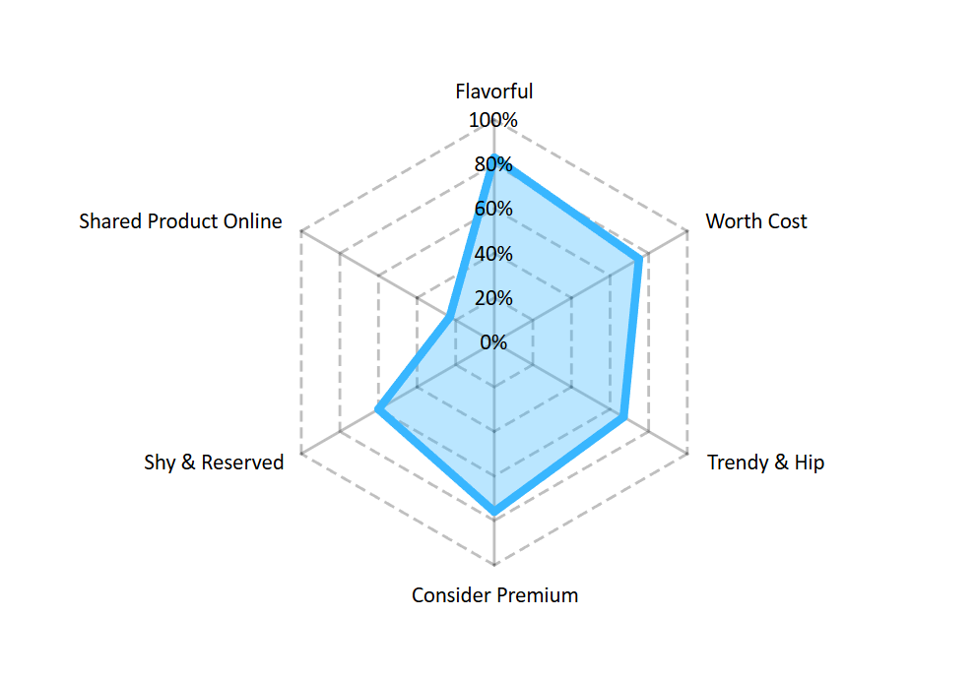
What is Jim Beams position in the market?
Jim Beam’s main surveyed demographic is millennials, with 67% of the surveyed falling within the 27-42 age range. The consensus is that Jim Beam is an affordable and trendy product that is seen as premium and bursting with flavor when compared to other brands. Inversely, few surveyed customers share their products online.
Shy & Reserved people may be more likely to engage in social media campaigns through bottles purchased at a store instead of at a bar. Only 24% of the surveyed have shared a product online so
an incentive will help engagement and fill a market niche.

Slide 10






What words come to mind when consumers think of Jim Beam and their competitors?
Smooth
Good
Good
Smooth
Good
Good
Smooth
Smooth
Good
Cool
Tasty
Strong
Bourbon
Quality
Smooth
Unique
Quality
Wax
Great
Nice
Quality
Taste
Strong
Premium
Best
Jim Beam stands out from other brands due to their aging process that affects taste and quality. Consumers understand this, and may be why this is the only brand to be called “Unique”
As a household name, its no surprise Jack Daniel’s has a well-rounded sentiment regarding quality and ease of drinking.
A “newcomer” when compared to some of the other brands, Maker’s Mark has been able to standout due the strength of their product and the quirk of their decorative wax.
Johnnie Walker is seen as a premium brand that goes down easy.
Only founded 36 years ago, Bulleit Bourbon has found their place as a trendy brand who delivers good taste.

